Slide 1
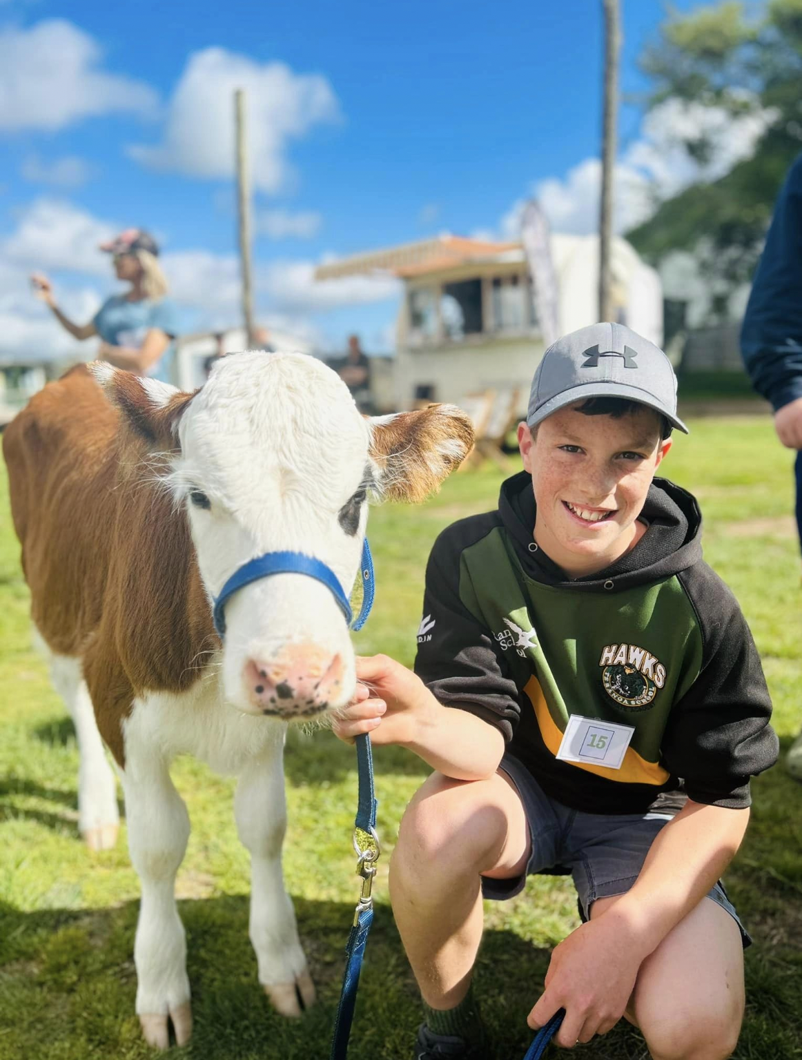
Te Ranga School
Strategic and Annual Plan
2023 - 2025

Slide 2
Contents
Introduction | About us, mission, vision, & values
Strategic Vision Page | Strategic Plan: 2024 - 2025 Plan on a page
Annual Plan | Te Ranga School Annual Plan 2023
Targets | Academic and Attendance Targets

Slide 3
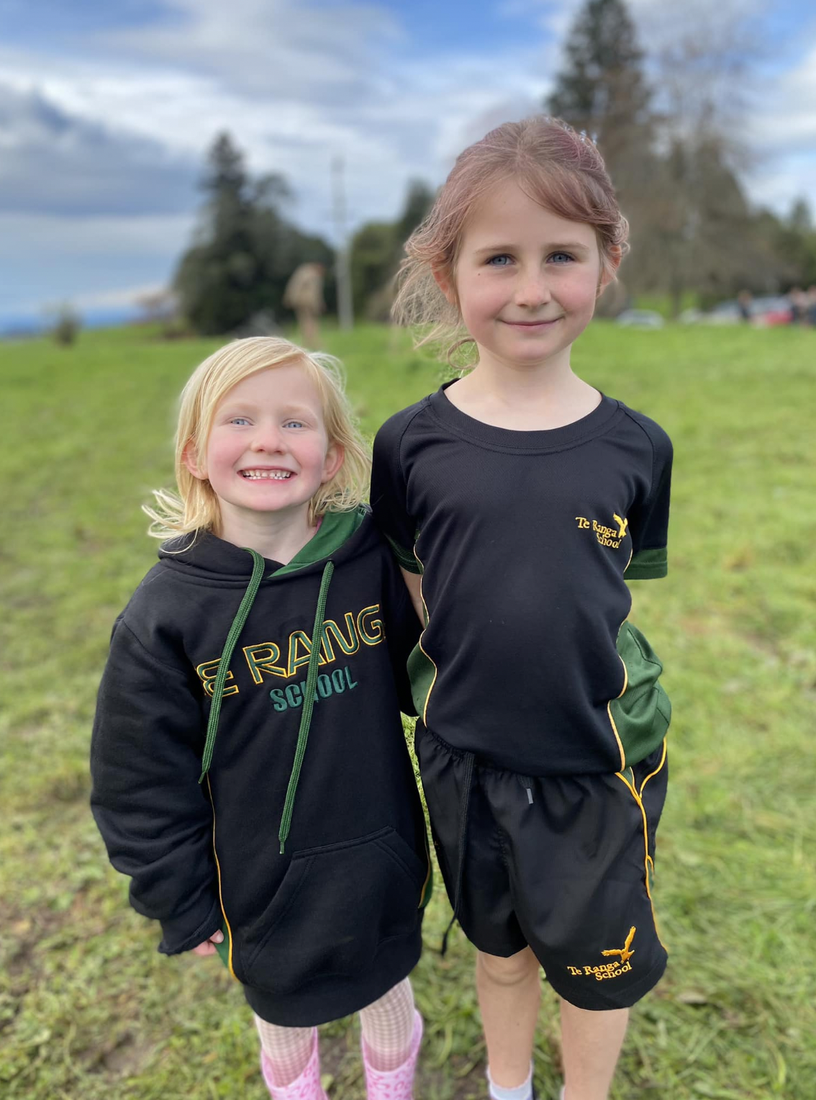
About us
Te Ranga School, nestled in the heart of The Bay of Plenty, is a welcoming community of 7 teachers and around 150 - 160 students from Year 1 to 8. Situated just 15 km southeast of Te Puke, our school has been a central part of the local rural community since 1927, offering quality primary education.
Our experienced staff are dedicated to the academic success and holistic development of all students at Te Ranga School.
We have a thriving local curriculum which encompasses our bush classroom, local experiences, and rural elements such as our annual lamb and calf day.

Slide 4
About Te Ranga School
To work in partnership with parents to challenge children to become confident, connected, actively involved, lifelong learners who are caring and responsible people.
Mission
Vision
To be a community-driven school dedicated to fostering academic achievement, holistic growth, and responsible citizenship.
Values
A School of HEART.
Honesty, Excellence, Accountability, Respect & Trust.

Slide 5
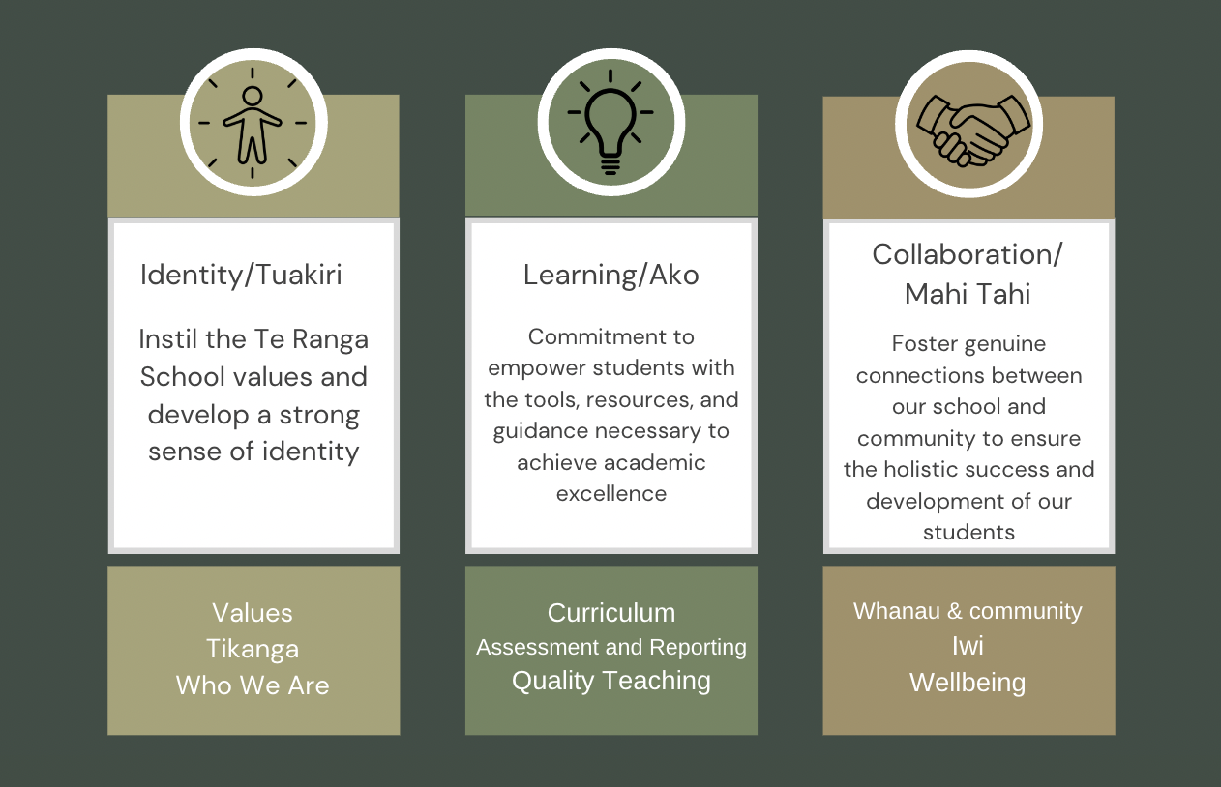
Strategic Goals

Slide 6
Identity/Tuakiri Instil the Te Ranga School values and develop a strong sense of identity
NELPS Objective 1 - Learners at the centre Objective 2 - Barrier free access
Action to be taken | Who is responsible | Resourcing | Timeframe | Evidence of success | Annual report & Variance statement
Maori Achievement Collaborative to attend a BOT meeting to discuss expectations | BOT & Principal | Time at BOT Meeting | Term 1 | Initial meeting completed with a follow up meeting planned. Robust conversations are had around this area and it’s importance
Complete a cultural review - Hautu with MAC | MAC & BOT | BOT Time | By the end of Term 2 | Board of Trustees including staff representative and principal have completed the Hautu review
Unpack Te Reo Maori lessons on TKI site with staff in a staff meeting | Principal Kahui Ako WST Teaching Staff | Time in staff meeting | By the end of Term 3 | Staff have completed 5x lessons per term from the TKI site/resource created from TKI site
Review “Start the day the Te Reo way” with teachers 1. Observation of teacher currently practising this 2. MAC to come model this to teachers at each year level | Kahui Ako WST Drew MAC Principal for coordination Teaching Staff | MAC bookings with Drew Templates for possible starters | By the end of Term 1 Drew models By the end of term 2, routine is established | Drew has come in and modelled this in each classroom. Teacher are confidently calling the roll in Te Reo/greeting in Te Reo
Begin ‘onlinekapahaka’ lessons weekly with the whole school | Kahui Ako WST Teaching Staff | $632.50 Time | Begin in Term 1 | Monday morning ‘whanaungatanga’ is established with hui and Reo/Waiata lessons

Slide 7
Create a cultural calendar of significant events in line with our school that can be celebrated throughout the year. Put these into the school calendar and plan appropriate celebrations around this. | SMT and Admin Teaching Staff | Time in the calendar | Created Prior to the start of Term 1 Events completed by end of Term 4 | Events are trialled this year and a PMI chart is created for each one to embed this for the future
Research in to PB4L and present to the BOT on the option of joining this scheme to create coherent and consistent positive behaviour management strategies | LSC, SMT and BOT | Time, surveys, Meetings | Prior to the end of Term 2 | SMT and BOT will have made a decision as to whether to opt into this or not. Begin the process if we decide to opt in.
Review the Te Ranga School ‘HEART’ values & consult with the community about their perspective on which values they believe should be taught/most relevant. Make steps to change these values | Principal SMT BOT | Time, surveys, Meetings | Prior to the end of Term 2 | Staff and BOT have made a decision whether to change our current values, or stick with them and revamp the way that they are taught schoolwide and in class
Create a bank of visually appealing signs, notices, certificates etc that represent our school values so that we can begin the promotion of values within the school | Engage with a Graphic Designer | $1800 |  | We will have create a bank of resource and designs that we can utilise for many different areas of school life
Review school mission statement and vision to assess its current relevance and how this is used | BOT | Time BOT Meeting | By the end of Term 3 | Updates are created on website, school community and staff are all aware of what these are
Te Ranga School vans are sign written so that they display a sense of pride and identity with our school | SMT Graphic Designer | $2500-$6000 | By the end of the School Year | New fleet of vans are fully signwritten with Te Ranga Logos
Implement a new procedure on school pack ups at the end of the day so that the school is left in a tidy state and students begin to take pride in their environment | Principal Teaching Staff | Procedure doc Meeting time | Prior to start of Term 1 | Each day after school the lost property and any rubbish is cleared and the grounds are in a presentable state

Slide 8
Learning/Ako Commitment to empower students with the tools, resources, and guidance necessary to achieve academic excellence
NELPS Objective 1 - Learners at the centre Objective 2 - Barrier free access Objective 3 - Quality teaching and leadership Objective 4 - Future of learning and work
Action to be taken | Who is responsible | Resourcing | Timeframe | Evidence of success | Annual report & Variance statement
Undertake professional development for all teaching staff and principal in E-Asttle assessments (Reading, Writing and Maths) | Principal MOE PLD provider Teaching staff | MOE funded PLD | By the end of Term 1 | All staff have a good understanding of the test and are able to use online reports to inform practice
Undertake ongoing professional development in the New Zealand Curriculum Refresh as opportunities become available | Principal and SMT Teaching staff | Meeting Time TOD $1000 for facilitator | Ongoing as new curriculum areas are released | English and Math curriculum areas are being planned for in the UKD model as of 2024
Provide tailored professional development for individual teachers which will be followed up with in their professional growth cycles | Principal SMT Teaching staff | $5000 PLD budget | PGC completed by end of 2024 | Through the professional growth cycle teachers have identified their own areas of development and are undertaking professional learning in this area
Update the teacher professional growth cycle, utilise time in staff meetings to review growth and implement coaching and mentoring sessions amongst teachers | Principal SMT Teaching staff | Staff meeting time | PGC completed by end of 2024 | Teachers are self reflective in their practice and have made steps towards their self-identified goals - evidence found in PGC documents.

Slide 9
Continue to both observe and model Prime maths in every classroom, provide troubleshooting and track data regularly with the implementation of the ‘one year’ books | HOD Maths Principal Teaching staff | HERO - Data tracking | By the end of 2024 | We have successfully tracked data using HERO to see continued improvement in mathematics results using the Pr1me system
Prioritise science as an area for growth in teachers. Students in Kahikatea and Totara are to compete in the science fair | Teaching staff | Classroom time - Budget for resources | End of Term 3 | Science fair has been completed by students in the school
Prioritise small group sessions in writing with an emphasis on differentiated learning | SMT Teaching staff | Call back day meeting time | By the end of 2024 | Writing results accelerated, more students making more than 12 months progress in a year.
Implement the iDeal subscription schoolwide as our phonics and spelling focus | SMT Teaching staff | $1800 | Prior to start of school 2024 | Student spelling results are greater than the previous year
Assessments to be completed end of Term 2 and Term 4 with a thorough analysis by SMT using HERO data tracking | Principal SMT Teaching staff | Training in staff meeting for assessment in Hero | By end of 2024 | SMT are fully educated on the data tracking capabilities of HERO, are able to share this with wider staff for analysis
Undertake school wide professional development in ‘Assessment for learning’ through evaluative associates (MOE funded PLD) | Principal SMT Teaching staff | MOE funded PLD | By end of term 2 | All staff have completed training in AFL and this is evident in their practice through PGC observations
Teacher Aids to be upskilled in areas of assessment | SENCO Support Staff | Release for SENCO | By end of term 1 | TA’s have used their funds for professional learning
Progressions in core curriculum areas to be revamped and uploaded to HERO | Principal |  | Prior to start of school 2024 | Reading, Writing and Maths progressions are on HERO and parents can see their child's progress
HERO to be used as the formal twice yearly written reporting tool for Te Ranga School | Principal Teaching staff |  | By end of 2024 | Reports are online and visible on HERO, completed twice by the end of 2024

Slide 10
Continue to provide a range of sporting experiences both competitively and to promote enjoyment and participation of students | SMT TIC Sport | $2500 Release days for TIC | By end of 2024 | Student voice from HAL survey has been taken into consideration, more activities students suggested are available
Emphasise importance of ‘The Arts’ at Te Ranga School by creating performance groups/clubs that can be opted into at break times (choir, drama, music etc.) | Principal Teaching staff | $$$ Teacher time | By end of term 3 | Teachers have run a club e.g. choir, drama, music etc. Scaling up of arts quest - completed at orchard church.
Create and resource a music and performing arts room - gain funding for this through grant applications | Principal DP | Principal to complete grant apps | By end of term 3 | “Old Rata’ is resourced with music equipment and instruments.
Utilise the professional development funds from the MOE to upskill current teacher aids | Principal Support Staff | MOE funds | By end of term 1 | TA’s have completed several programmes - writing emphasis
School library moved to school grounds, updated books, and new shelving. Children can run lunchtime clubs in the library. | Principal Librarian Student Council | FOTR money | By end of term 1 | Library is regularly utilised, the student council are running a book club/chess club/board games club etc.
Solidify what is “Te Rangatanga” - our local curriculum. | Principal SMT Teaching staff |  | By end of term 2 | A ‘prospectus’ type booklet is created, demonstrating what is unique to Te Ranga
Outside educators to come and teach bush classroom lessons - for students and professional development of teachers | TIC Bush classroom Principal | $5000 | By end of term 2 | Outside educators have come in several times per term to teach lessons, teacher are reflective on this in PGC
Create a resource bank of lessons for the bush classroom which are levelled appropriately | TIC Bush classroom Principal | Teacher time | By end of term 4 | TIC bush classroom has pre-made lessons plans with appropriate resources which can be picked up and taught from.

Slide 11
Collaboration/Mahi Tahi Foster genuine connections between our school and community to ensure the holistic success and development of our students
NELPS Objective 1 - Learners at the centre Objective 2 - Barrier free access Objective 3 - Quality teaching and leadership Objective 4 - Future of learning and work
Action to be taken | Who is responsible | Resourcing | Timeframe | Evidence of success | Annual report & Variance statement
Create school/home community connections by inviting parents to school more regularly to be involved in day to day activities such as bush classroom, technology, gardening etc. | Teaching Staff Principal | TBC per event | By end of term 4 | Parents are coming up to run clubs such as gardening clubs, coaching touch etc. High community engagement at school events
Plant school gardens, and establish this as a ‘community’ project | Teaching Staff Principal Community | $500 for gardening | By end of Term 2 | Vege gardens planted , established and maintained.
Hold CAKE night early in the year and provide community consultation on the schools ‘Health Statement’ | Principal DP |  | By end of term 1 | A new health statement is constructed and uploaded to SchoolDocs in line with parental feedback
Provide workshops for parents in different learning areas of the school | Teaching Staff | Teacher time | By end of term 1 | Each teacher has held a workshop in an area of responsibility for parents

Slide 12
Create a schoolwide consistent approach to homework - same expectations for all classes | Teaching Staff Principal | Call back day | Prior to school starting 2024 | Expectations on teachers and students are fulfilled and regularly checked in on
Implement the William Pike Challenge into Kahikatea Class for students to grow in high school preparedness | Hawk Academy Teacher | $1500 TIC release | By end of term 4 | Students have completed 5 EOTC activities, 20 hours community service, and 20 hours passion project
Engage with Te Puke High School regularly for opportunities for Kahikatea students to visit the school and ensure a smooth transition | Hawk Academy Teacher Principal |  | Continuous | Year 8 students have visited the high school 2-3 times throughout the year
Grow staff knowledge in wellbeing programmes so that these become a whole school approach and part of teaching and learning | HAL Leaders Sport Coordinator | Staff meeting time | By end of term 4 | HAL leaders have run a staff meeting on Hauora and what initiatives we have/could implement
Health and PE programmes are supported by the HAL initiative | HAL Leaders Sport Coordinator |  | By end of term 4 | Continued support from Sport BOP through HAL
Apply to Tu Manawa Active funding for the William Pike Challenge | TIC Sport Principal HAL leaders | Grant Money | By end of term 1 | Money for EOTC activities through Tu Manawa obtained
Accruing support from Health Active Learning Community Connectors for community collaboration | HAL Leaders Sport Coordinator |  | By end of term 4 | HAL leaders have assisted in our community initiatives
Professional development provided in Hauora and PE | HAL Leaders Sport Coordinator | Staff meeting time | By end of term 4 | Has been provided by HAL
Continue with the cohort entry scheme and transition programme for New Entrants. NE teacher to visit preschools once per term | New Entrant Teacher | Transport Resources | Continuous | NE teacher has visited local preschools at pickup time and liaised with parents each term

Slide 13
Hold a whanau hui at least once per year in town to gain perspective and insight on their wants and wishes for their students | Principal SMT | $150 for kai + Venue | By end of term 4 | Meeting in town with kai has been conducted, parental voice recorded
Engage with Kahui Koeke 1. Invite up to school for an initial contact 2. liaise with representatives from Marae 3. Find out what the school can do for them 4. Invite up to school for relevant events | Principal and Kahui Ako Rep | 1. Budget for kai 2. Marae visits - camp budget | Engagement with Koeke and Marae trip by end of Term 2 School Events - ongoing | School has fostered open communication with Koeke who comes to school for events. School is actively engaging with Koeke to find out what we can do to support iwi.
Collaborate with the MAC to create progressions for Te Reo at Te Ranga | Principal Kahui Ako WST | MAC bookings with Drew | By the end of 2024 | Drew has worked with us to create Te Reo progressions that are being actively used
Empower and resource students to confidently welcome on guests with mihi whakatau | Teachers Willow Kahui Ako WST | Time with Willow | By the end of 2024 | Whakatau are conducted each term for new students/staff and special guests
Principal and Bush Classroom lead are to engage with the Paraiti Group each month | TIC Bush Classroom Principal | Meeting room | Continuous | Paraiti group meeting regularly attended, actions are met
Bring back the ‘Possum and Pest Hunt’ for 2024 with an ‘environmentally friendly’ theme, where we can educate the community and foster collaboration and engagement | Principal Teaching Staff FOTR Community | FOTR meetings $$$ Time | By end of term 3 | Possum and Pest Hunt held in 2024, monetary value gained as well as a positive connection between school - iwi and community
Hold a parent evening on digital safety - “our kids online” programme | Principal Teaching staff | Purchase of programme | By end of term 2 | Parent evening held using ‘our kids online’
Run a day trip/overnight stay at school for other small rural schools year 8’s at Te Ranga | Hawk Academy Teacher SMT | Planning time $500 | By end of term 2 | Rural schools collaborate at the beginning of the year for an overnight camp where they can get to know each other

Slide 14
MOE Attendance Targets
Measure | 2023 Actual | 2024 MOE Target | 2026 MOE Target
Percentage of akōnga attending school regularly (attending more than 90%, an average of 9 days a fortnight) | 70% | 70% | 75%
Percentage of akōnga who are moderately absent (attending more than 70% up to 80%, missing two to three days a fortnight) | 4% | 6% | 4%
Percentage of akōnga who are chronically absent (attending 70% or less, missing three or more days a fortnight) | 3% | 5% | 3%

Slide 15
Academic Targets
Whole school achievement in Reading 80% or higher
Whole school achievement in Writing 80% or higher
Whole school achievement in Maths 80% or higher
Increase % of boys achievement in writing by 5%
Raise Year 2 Achievement in reading by 20%

